Slide 1

ITT632
MOBILE CLOUD COMPUTING
Dr. Mohd Faisal Ibrahim

Slide 2
Mobile Cloud Computing Taxonomy
Chapter 1

Slide 3




Topic Covered
1
Overview of Cloud Computing
2
Mobile Cloud Solutions

Slide 4
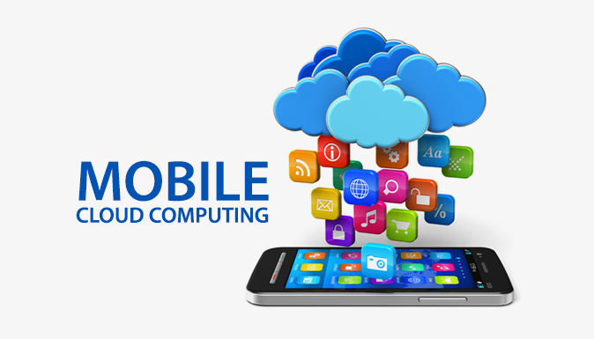
Overview of Cloud Computing

Slide 5
What is Cloud Computing (CC)?
Cloud computing is a model for enabling ubiquitous, convenient, on-demand network access to a shared pool of configurable computing resources (e.g., networks, servers, storage, applications, and services) that can be rapidly provisioned and released with minimal management effort or service provider interaction.
A project follows a hierarchy of assumptions and objectives:
  Inputs
  Activities
  Proposals
  Outputs
  Goals

Slide 6
essential characteristics Of CC
On-demand self-service. A consumer can unilaterally provision computing capabilities, such as server time and network storage, as needed automatically without requiring human interaction with each service provider.
Broad network access. Capabilities are available over the network and accessed through standard mechanisms that promote use by heterogeneous thin or thick client platforms (e.g., mobile phones, tablets, laptops, and workstations).
Resource pooling. The provider’s computing resources are pooled to serve multiple consumers using a multitenant model, with different physical and virtual resources dynamically assigned and reassigned according to consumer demand. There is a sense of location independence in that the customer generally has no control or knowledge over the exact location of the provided resources but may be able to specify location at a higher level of abstraction (e.g., country, state, or data center). Examples of resources include storage, processing, memory, and network bandwidth.
Rapid elasticity. Capabilities can be elastically provisioned and released, in some cases automatically, to scale rapidly outward and inward commensurate with demand. To the consumer, the capabilities available for provisioning often appear to be unlimited and can be appropriated in any quantity at any time.
Measured service. Cloud systems automatically control and optimize resource use by leveraging a metering capability at some level of abstraction appropriate to the type of service (e.g., storage, processing, bandwidth, and active user accounts). Resource usage can be monitored, controlled, and reported, providing transparency for both the provider and consumer of the utilized service.

Slide 7
CC Service models
Software as a Service (SaaS).
  The capability provided to the consumer is to use the provider’s applications running on a cloud infrastructure.
  The applications are accessible from various client devices through either a thin client interface, such as a web browser (e.g., web-based e-mail), or a program interface.
  The consumer does not manage or control the underlying cloud infrastructure including network, servers, operating systems, storage, or even individual application capabilities, with the possible exception of limited user-specific application configuration settings.
Platform as a Service (PaaS).
  The capability provided to the consumer is to deploy onto the cloud infrastructure consumer-created or acquired applications created using programming languages, libraries, services, and tools supported by the provider.
  The consumer does not manage or control the underlying cloud infrastructure including network, servers, operating systems, or storage, but has control over the deployed applications and possibly configuration settings for the application-hosting environment.

Slide 8
CC Service models (1)
Infrastructure as a Service (IaaS).
  The capability provided to the consumer is to provision processing, storage, networks, and other fundamental computing resources where the consumer is able to deploy and run arbitrary software, which can include operating systems and applications.
  The consumer does not manage or control the underlying cloud infrastructure but has control over operating systems, storage, and deployed applications; and possibly limited control of select networking components (e.g., host firewalls).
Cloud computing classification

Slide 9
CC deployment models
1
Private cloud. The cloud infrastructure is provisioned for exclusive use by a single organization comprising multiple consumers (e.g., business units). It may be owned, managed, and operated by the organization, a third party, or some combination of them, and it may exist on or off premises.
2
Public cloud. The cloud infrastructure is provisioned for open use by the general public. It
may be owned, managed, and operated by a business, academic, or government organization, or some combination of them. It exists on the premises of the cloud provider.
3
Hybrid cloud. The cloud infrastructure is a composition of two or more distinct cloud infrastructures (private, community, or public) that remain unique entities, but are bound
together by standardized or proprietary technology that enables data and application
portability (e.g., cloud bursting for load balancing between clouds).
4
Community cloud. The cloud infrastructure is provisioned for exclusive use by a specific
community of consumers from organizations that have shared concerns (e.g., mission,
security requirements, policy, and compliance considerations). It may be owned, managed,
and operated by one or more of the organizations in the community, a third party,
or some combination of them, and it may exist on or off premises.

Slide 10
What is Mobile computing (MC)?
Focuses on device mobility and context awareness considering networking and mobile resource/data access.
MC applications usually rely on mobile devices to create, access, process, store, and communicate information without being constrained to a single location.
MC usually considers similar types of mobile devices that offers many otherwise unattainable benefits to organizations that choose to integrate it into their fixed information system.

Slide 11
essential characteristics Of MC
Portability. The era of focus on portability was about reducing the size of hardware to enable the creation of computers that could be physically moved around relatively easily.
Miniaturization. Miniaturization was about creating new and significantly smaller mobile form factors that allowed the use of personal mobile devices while on the move.
Connectivity. Connectivity was about developing devices and applications that allowed users to be online and communicate via wireless data networks while on the move.
Convergence. Convergence was about integrating emerging types of digital mobile devices, such as smart phones, music players, cameras, games, etc., into hybrid devices.
Divergence. Divergence took an opposite approach to interaction design by promoting information appliances with specialized functionality rather than generalized ones.
Applications. The latest wave of applications is about developing matter and substance for use and consumption on mobile devices, and making access to this fun or functional interactive application content easy and enjoyable.
Digital ecosystems (e.g., IoT). Finally, the emerging wave of digital ecosystems is about the larger wholes of pervasive and interrelated technologies that interactive mobile systems are increasingly becoming a part of.

Slide 12
What is Mobile Cloud Computing (MCC)?
MCC leverages unified elastic resources of varied clouds and network technologies toward unrestricted functionality, storage, and mobility to serve a multitude of mobile devices anywhere, anytime through the Internet, regardless of heterogeneous environments and platforms based on the pay-as-you use principle.
This definition is a combination of cloud computing and mobile computing by describing MCC’s service features focusing on how mobile devices acquire and then use cloud computing based services through mobile networks.

Slide 13
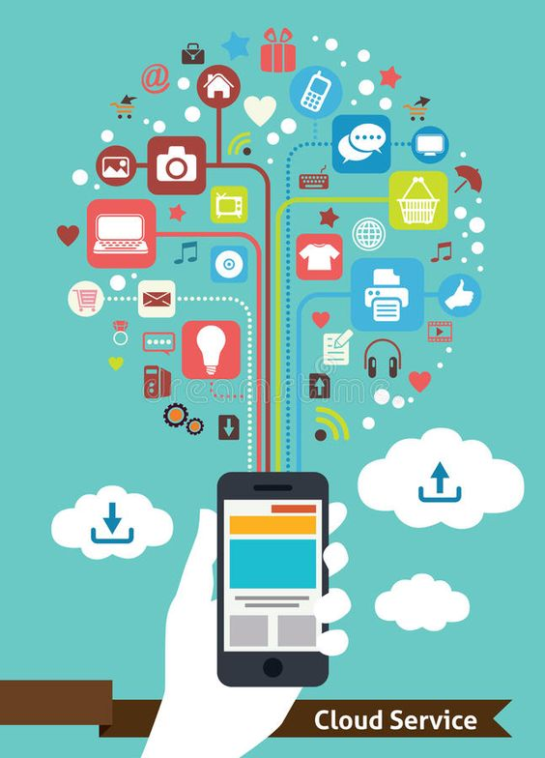
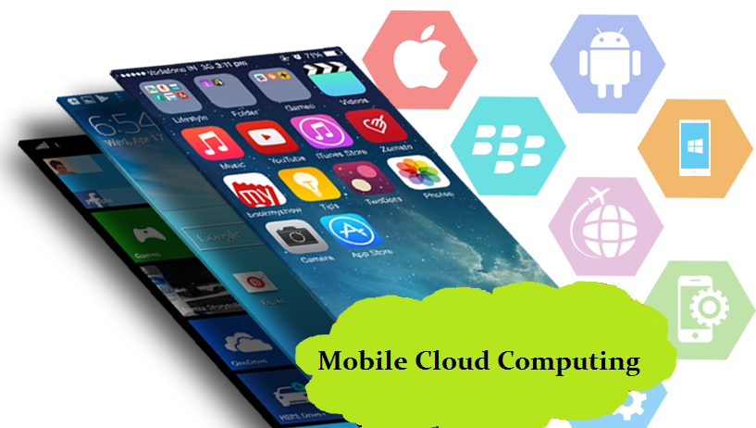
Mobile Cloud Solutions

Slide 14

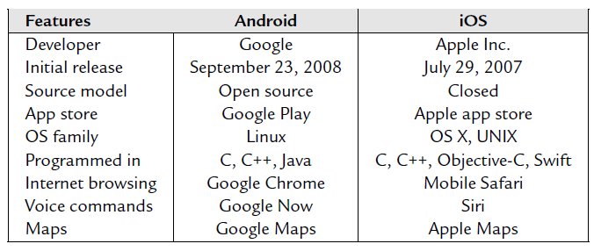
Mobile Platforms
The mobile applications are developed on various platforms. Two platforms comprising the largest share of the current market are Apple iOS and Google Android.
Apple iOS
Mobile OS
Android
KaiOS

Slide 15
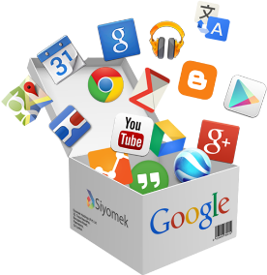
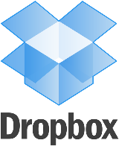
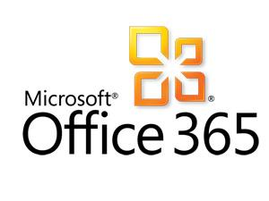
Cloud-based Mobile Service Platforms
Some of the current cloud service platforms that support mobile applications/services:
Google maps
Google Services
Google Translate
Google Docs
Dropbox, cloud storage
Microsoft Office365
  Yelp (Cloud-based Virtual Augment)
  Internet of Things (Cloud Mirroring)

Slide 16
Google Services
Google Maps is a Google satellite, which gives an in-depth accurate map of almost every city in the world. Google maps gives directions from how to get from one point to the other, figures out the quickest route possible, and gives an Earth/Satellite/Street view. Maps is available on browsers as well as mobile phones, allowing custom maps as well as saved directions to be saved on Google Accounts and later be accessed from all devices. The map itself is downloaded from the cloud server when the user browses it. If user would like to know the route to some destination, the cloud server calculates the best route and sends it to users’ devices.
Google Translate is an online translating tool, which translates text from one language to the other instantly for a user. The phone does not store all the language mappings. Words or statements are sent to the cloud server to be calculated to the target language, in which processes, the machine learning and natural language processing techniques, are used to enhance the translation accuracy, which cannot be achieved using the limited resources on smartphones.
Google Docs are online applications, which allow people to create, edit, or view different types of documents. In addition to word documents, Google Docs also support Power-Point slides and Excel spreadsheets. Google Docs can be synchronized across all devices through a user’s Google account. This allows the user to access his/her documents on any device as long as he/she can access Google Docs’ server using a browser, and edit and share them without time and location restrictions.

Slide 17
Dropbox, cloud storage
Dropbox is a popular cloud-based storage service which supports mobile devices.
It can help users store photos, docs, videos, and other files in clouds.
Files in Dropbox are tracked with a version control system, each version is backed up, and users can access them using their mobile devices.
It provides an easy approach to share a large file by sharing their Dropbox’ URL even if a user does not have a Dropbox account.
A Drobox client is required to be installed on mobile devices in order to manage files in the cloud.
Compared to the desktop Dropbox client, the mobile version only downloads the files to mobile devices as the user instructs it to do so.
When some files are added, deleted, or updated, new versions of files are synchronized to the cloud storage and all devices having the same Drobox account will perform an update.
In this way, the new version is pushed to every device controlled by the same user and his/her file sharing peers.

Slide 18
Dropbox, cloud storage (1)
The Dropbox API v23 is a set of HTTP endpoints that help your app integrate with Dropbox.
The officially supported SDKs, which are programming language wrappers of the HTTP API, include .NET, Java, JavaScript, Python, Swift, and Object-C.
The Dropbox HTTP API allows developers to work with files in Dropbox, including advanced functionality like full text search, thumbnails, and sharing.
Dropbox also provides Business API that allows apps to manage the user lifecycle for a Dropbox Business account and perform API actions on all members of a team.

Slide 19
Office365, cloud based collaboration
Microsoft Office365 is made for company employees to work together, sharing similar features with Drobox and Google Docs.
Users can share docs with their working partners right from a phone and tablet.
Mobile version Office365 along with Microsoft Azure provides:
Easily sharing documents with the cloud-connected applications;
Tracking changes, comment and mark-up docs so that everyone knows documents’ change history;
Sharing documents with others by simply e-mailing an URL.

Slide 20
Yelp, cloud based virtual augment
Yelp application has a feature called Monocle, which is an application of cloud-based virtual augmentation.
When the user points the phone camera to one direction, the shops and restaurants are displayed as an additional layer in front of the background photo.
The Monocle application captures the location and direction, fetches the data from the cloud, and organizes shop information on the photo, such as the notes to the real environment.

Slide 21
Internet of things, cloud mirroring
The Internet of Things (IoT) is the network of physical objects—devices, vehicles, buildings, and other items which are embedded with electronics, software, sensors, and network connectivity, which enables these objects collect and exchange data.
The Internet of Things allows objects to be sensed and controlled remotely across existing network infrastructure, creating opportunities for more direct integration of the physical world into computer-based systems, and resulting in improved efficiency, accuracy, and economic benefit; when IoT is augmented with sensors and actuators, the technology becomes an instance of the more general class of cyber-physical systems, which also encompasses technologies such as smart grids, smart homes, intelligent transportation, and smart cities.
Experts estimate that the IoT will consist of almost 50 billion objects by 2020.

Slide 22
Internet of things, cloud mirroring (1)
However, due to the large amount of objects, small systems cannot handle huge data collected through IoT devices.
To address this issue, cloud-based storage services come into the picture.
IoT objects can be continuously mirrored by using cloud-based monitoring and storage services; while individual or group of IoT device(s) can be virtualized and manipulated in the cloud for MCC applications, and then control or data operation functions can be executed on physical devices.

Slide 23
Mobile Cloud Offloading, Composition and Migration
In a mobile cloud, mobile nodes are usually restricted by their energy supply.
Many mobile cloud computing solutions have been recently proposed to describe how to offload applications from mobile devices to surrogates, which usually have high computation capabilities with constant power supplies.
One mobile cloud application scenario is when a mobile device offloads one or multiple applications to an Internet cloud.
Another scenario is when the Internet cloud is not available, and thus a mobile device can offload its applications to other mobile devices to share the computation overhead.
In this scenario, each mobile node in a mobile cloud can be considered a surrogate.

Slide 24
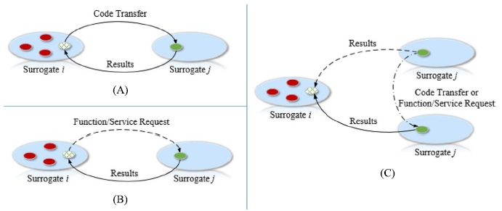
Mobile Cloud Offloading, Composition and Migration
Mobile cloud terminologies: (A) Offloading, (B) Composition, and (C) Migration

Slide 25
Mobile Cloud Application Partition and Offloading Decision
Three aspects are generally taken into consideration to model the application partition problem:
Device profiles. The cloud virtual machine computation power is usually several times better than that of the mobile devices, which contributes to execution time modelling. The energy consumption of the CPU and Radio modules on the phone are generally categorized as active and standby parts.
Application profile. Mobile applications are usually modelled as a directed acyclic graph (DAG), where the vertices are the application modules and the edges are module dependencies or data flow.
Environment profile. The connection between mobile devices and clouds plays pivotal role in the partition strategy. Especially the wireless connection such as WiFi or cellular connection is not always stable.

Slide 26
Mobile Cloud Offloading Framework
Recent mobile cloud infrastructure and framework:
CloneCloud
ThinkAir
MAUI
Cuckoo
Weblet
Cloudlet

Slide 27
CloneCloud
Clone Cloud is a proposed technique for Energy Saving in Mobile Cloud Computing.
It is a system that automatically transforms mobile applications or part of them to be executed in the cloud.
Each mobile device is associated to a clone cloud which extends the mobile device capabilities.
This is done by an application’s practitioner that partitions an application-level executing on a virtual machine, and execution runtime controller that seamlessly off-load some of these partitions execution from the mobile device onto a mobile clone in the cloud.
Clone Cloud overcomes the limited computation power, memory, and energy of mobile devices.
As a result, a single-machine execution application is transformed into a distributed-execution application as shown in Figure.
CloneCloud system model. CloneCloud transforms a single machine execution (mobile device computation) into a distributed execution (mobile device and cloud computation) automatically.

Slide 28
CloneCloud (1)
The rationale behind the Clone Cloud model is stating that as long as the execution power is better, faster, cheaper, and secure on the cloud than on the mobile device, it is worth transforming the expensive parts to be executed in the cloud.
A design goal is to let the Clone Cloud decides on which and where; which portion of the code is better to be executed on the mobile device verses Clone Cloud, without modifying the application code or forcing a programmer to change the application implementation, and without having the end user to worry about how the execution distribution is done.
The architecture of the Clone Cloud is provided in Figure.
It consists of a mobile device and a clone virtual machine (VM) on the cloud.
The CloneCloud prototype architecture

